Slide 1
Deep Learning
Generated for: Create a 3-slide PPT on Convolutional Neural Networks (CNN)., Subject: Deep Learning, Slide titles:, Slide 1: Introduction to Convolutional Neural Networks, Slide 2: Core Components of CNN, Slide 3: Applications of CNN, Generate content for each slide based on its title.
Notes:
Welcome to the Deep Learning presentation covering multiple topics. Today we'll explore: Create a 3-slide PPT on Convolutional Neural Networks (CNN)., Subject: Deep Learning, Slide titles:, Slide 1: Introduction to Convolutional Neural Networks, Slide 2: Core Components of CNN, Slide 3: Applications of CNN, Generate content for each slide based on its title..

Slide 2
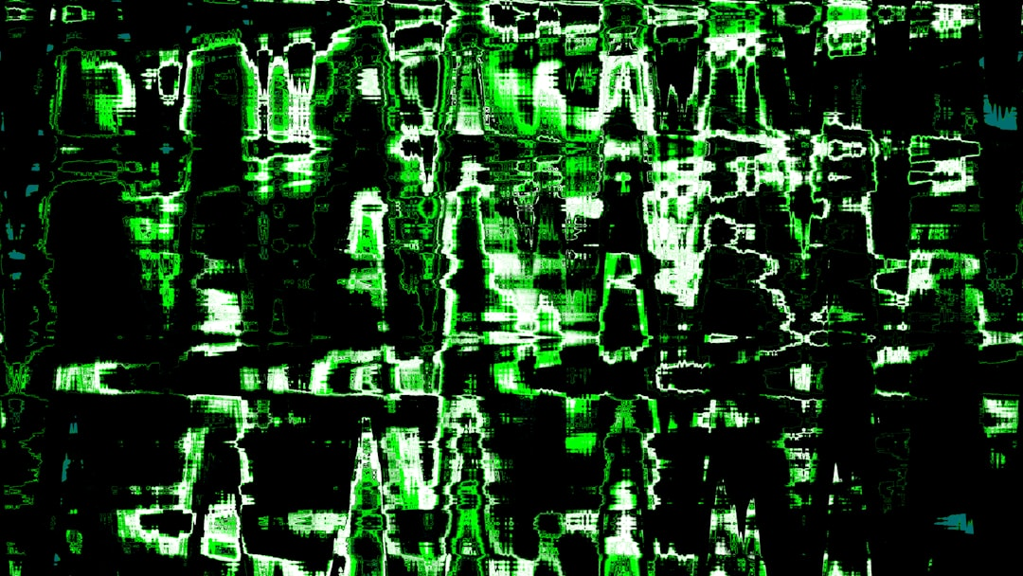
Create a 3-slide PPT on Convolutional Neural Networks (CNN). - Introduction
Convolutional Neural Networks are deep learning models
Inspired by biological neural networks and visual cortex
Used for image classification, object detection tasks
Consist of convolutional, pooling, fully connected layers
Convolutional layers extract local features from images
Pooling layers reduce spatial dimensions of data
Fully connected layers classify input images
Activation functions introduce non-linearity in models
Backpropagation algorithm trains CNN models
Optimization techniques improve model performance
Notes:
Introduce Convolutional Neural Networks as a type of deep learning model inspired by the structure and function of the human visual cortex. Explain that CNNs are commonly used for image classification, object detection, and other computer vision tasks. Highlight the key components of a CNN, including convolutional, pooling, and fully connected layers. Emphasize the importance of activation functions and backpropagation in training CNN models. Provide examples of applications, such as self-driving cars and facial recognition systems, to illustrate the practical uses of CNNs. Ask students to consider the advantages and limitations of using CNNs for different tasks.

Slide 3
Create a 3-slide PPT on Convolutional Neural Networks (CNN). - Part 2
(AI could not generate this slide)

Slide 4
Create a 3-slide PPT on Convolutional Neural Networks (CNN). - Part 3
(AI could not generate this slide)

